Slide 1


Slide 2
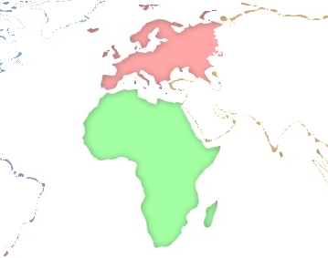



Notes:
2

Slide 3

INDEX
INTRODUCTION
LOCATION
LOCAL PHOTOS
LOCATION DESCRIPTION
INFRASTRUCTURES
PROJECT
CONTACTS
Notes:
3

Slide 4

INTRODUCTION
"Africa in Europe" will be a permanent exhibition from all countries in Africa, in order to connect them into a single efficient and modern infrastructure, with financial, business, logistics and cultural centres in Europe and strengthen their presence, interactivity and businesses in these areas.
The aim is to increase trade and investment between Africa and Europe, the two neighboring continents, creating a space with 2 million square meters in the Madrid region.
Madrid, capital of Spain, is an unrivaled geostrategic location as a natural bridge between Europe, Africa and America and, specially, Portugal. "Africa in Europe" is a unique and emblematic project, designed for the African governments and companies. It offers modern spaces, designed specifically for each activity and completely integrated in the most important international air, maritime and land connections, incorporating the latest information and communication technology.
All this, together with the significant presence of Spain in the most prominent European and international institutions and forums in financial, business and cultural areas, makes this combination unbeatable with factors that guarantee the global success and the spreading of "Africa in Europe “ project.
Notes:
4

Slide 5

LOCATION
Notes:
5

Slide 6
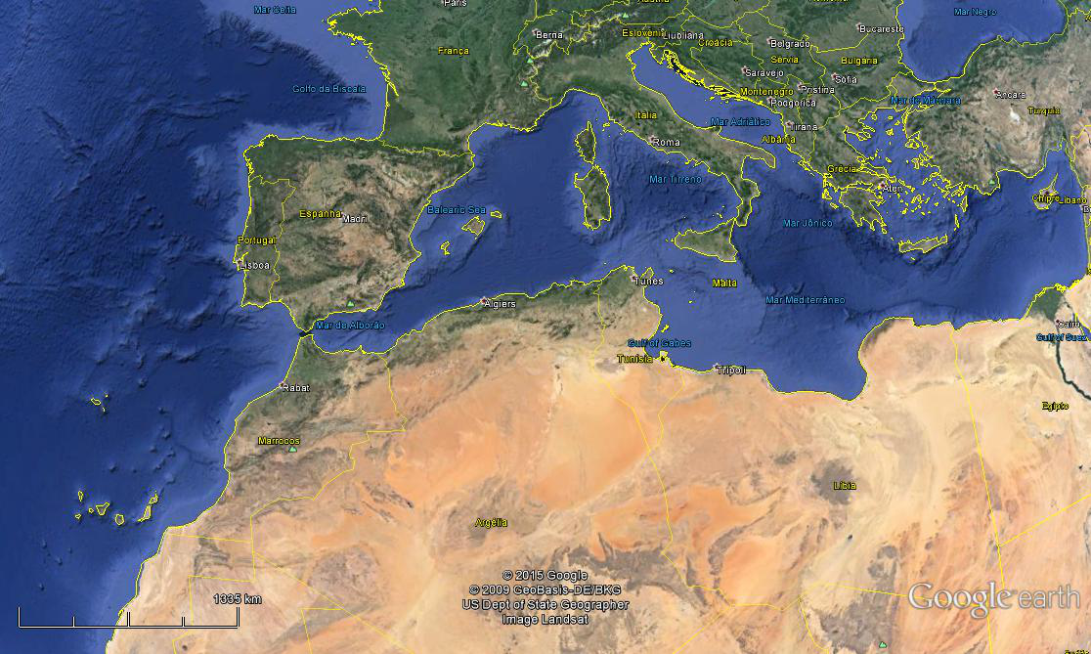

Notes:
6

Slide 7
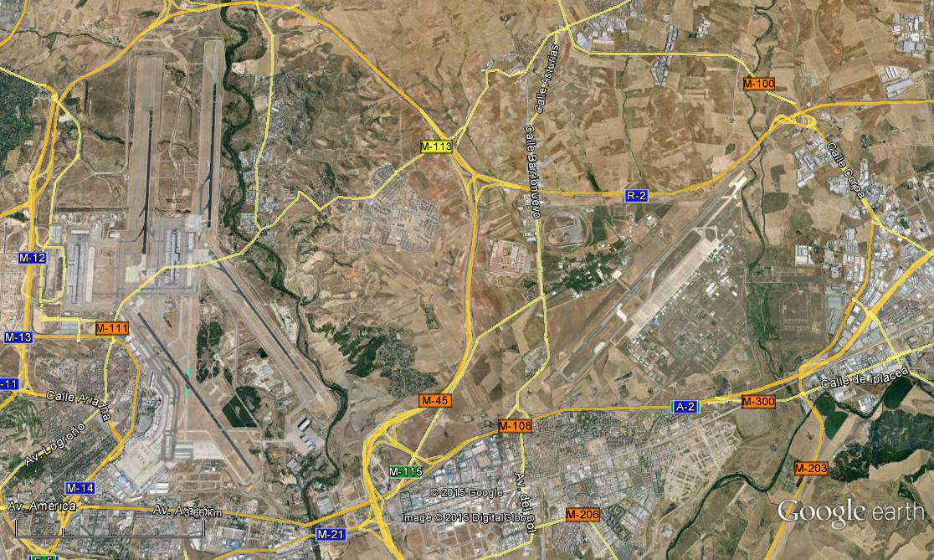

Madrid-Barajas
International
Airport
Torrejon
Private
Airport
Notes:
7

Slide 8

LOCAL PHOTOS
Notes:
8

Slide 9
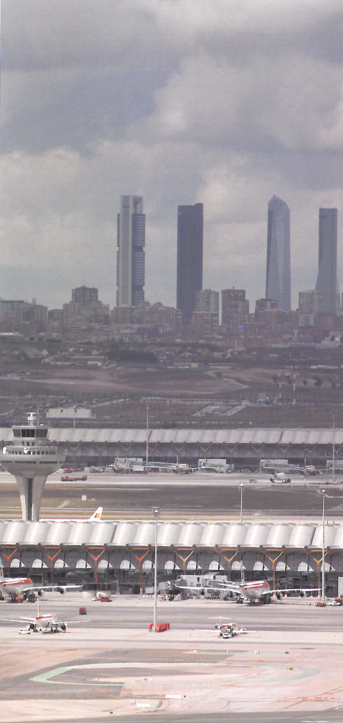
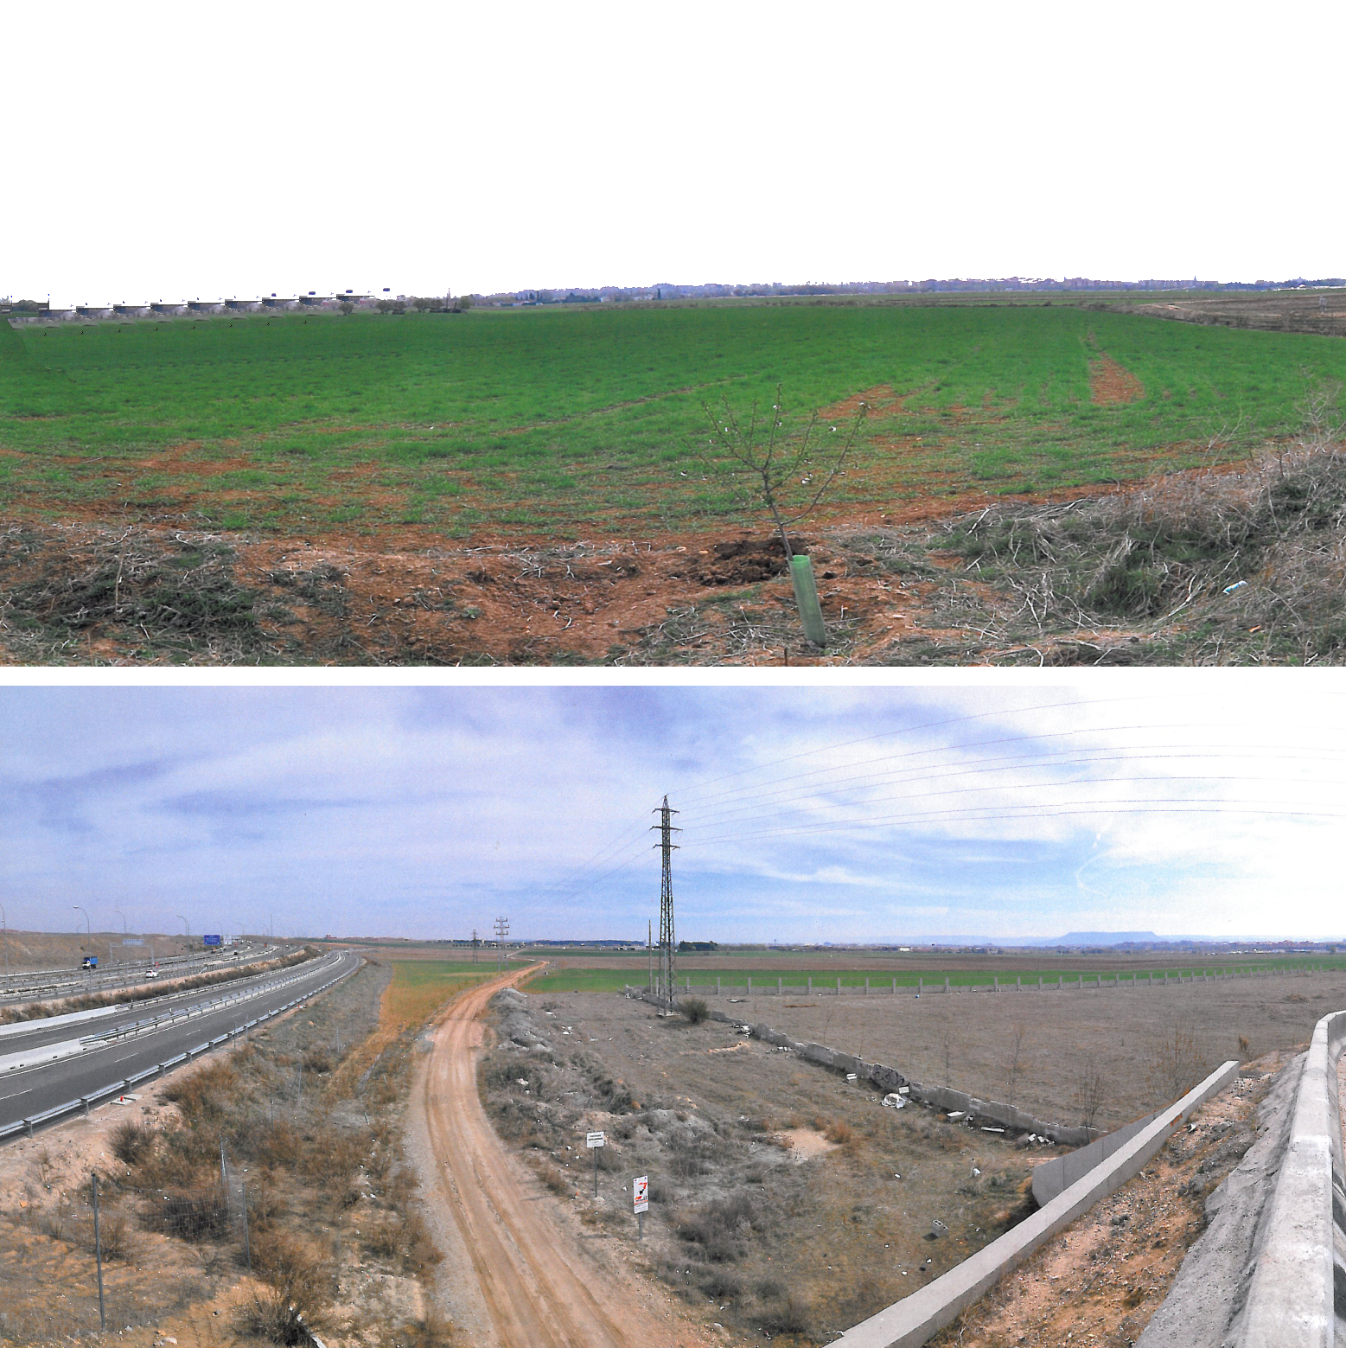
Notes:
9

Slide 10
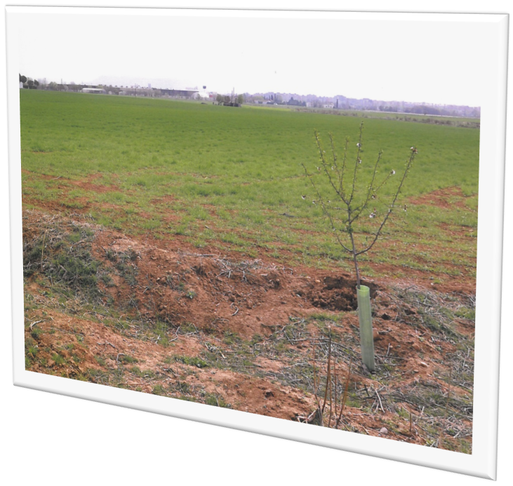
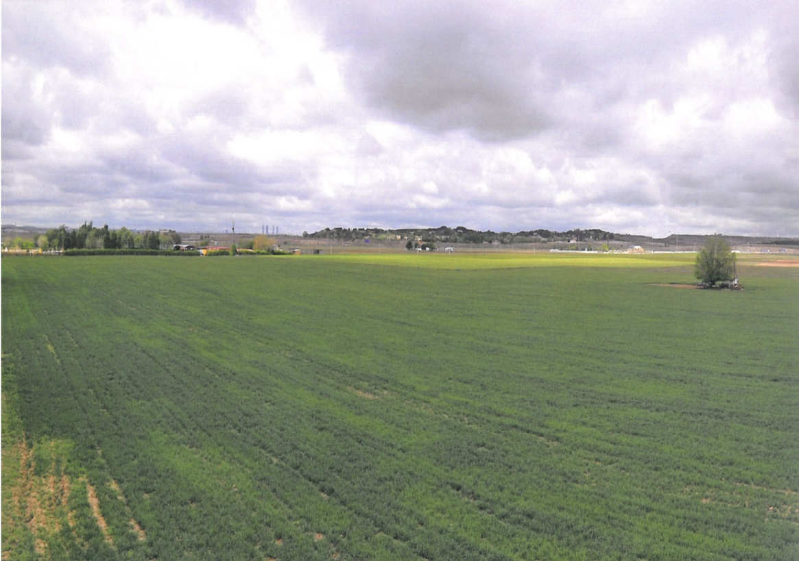
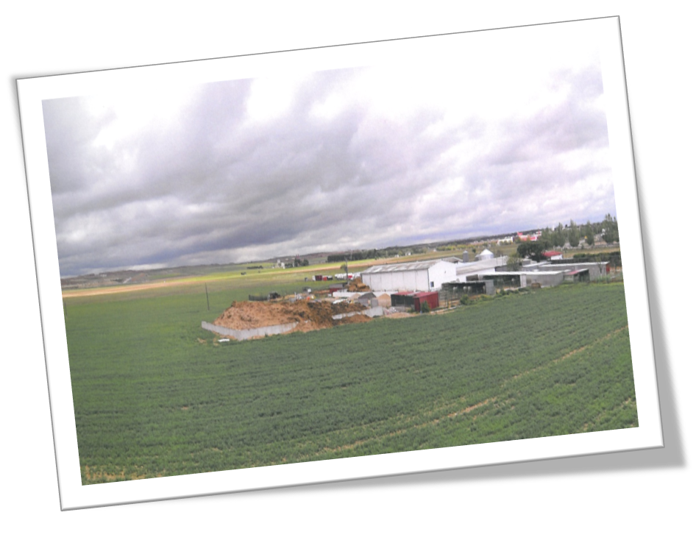
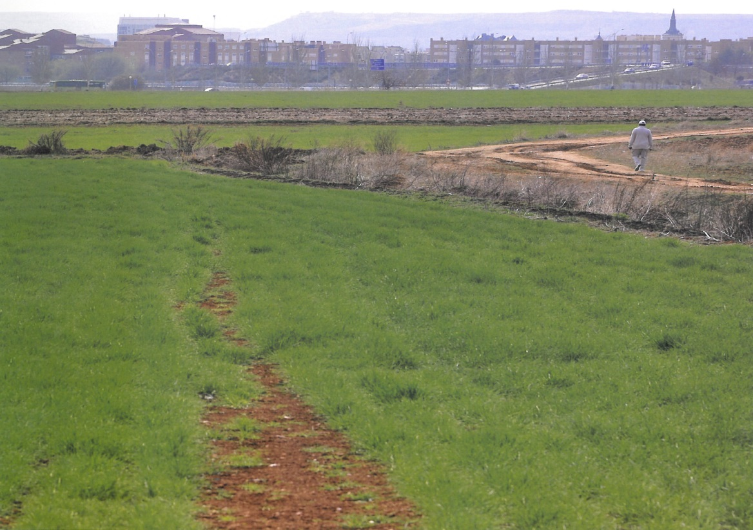
Notes:
10

Slide 11

LOCATION DESCRIPTION
Notes:
11

Slide 12
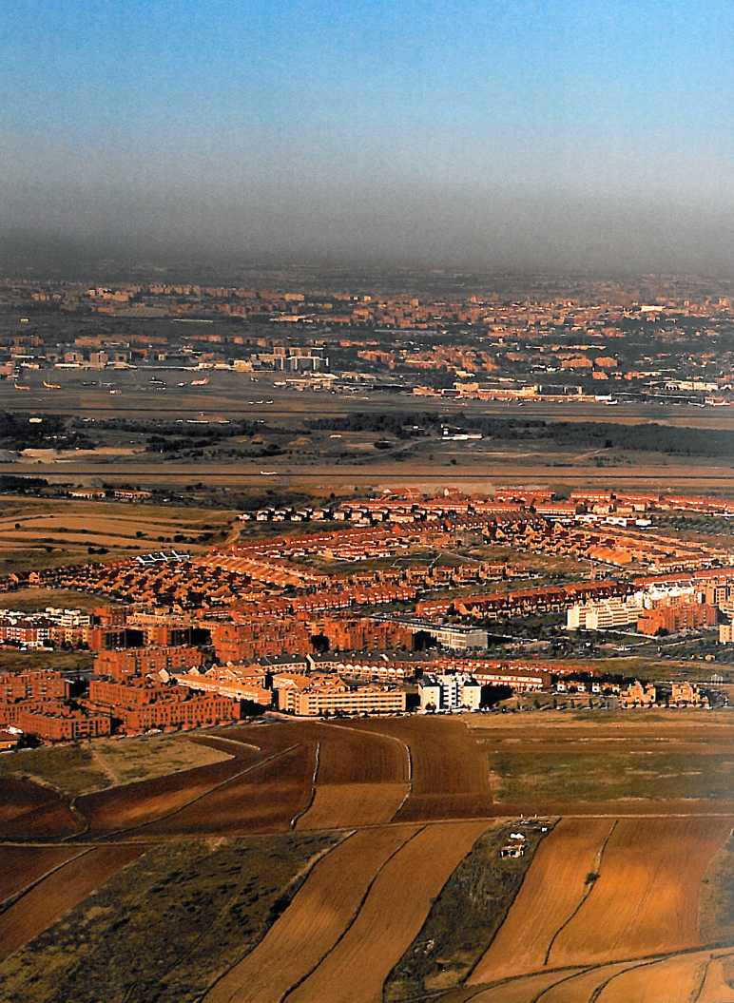
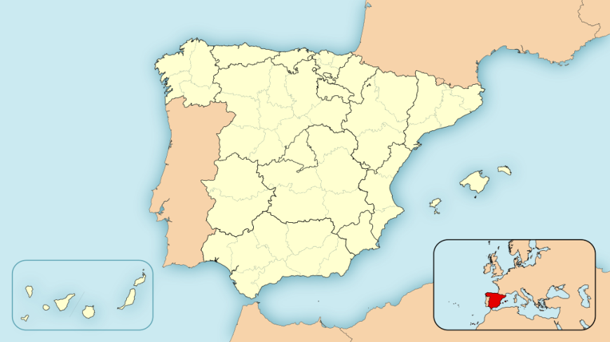
Madrid is the capital and the largest city in Spain. It has a population of approximately 3.3 million people, with a metropolitan area round about 6.5 million inhabitants.
It is the third largest city in the European Union (EU), after London and Berlin. Its metropolitan area is the third largest in the EU, after London and Paris.
The urban area of the Spanish capital covers a total of 604.3 Km2.
The city is located on the river Manzanares in the centre of the country and the Community of Madrid (that encompasses the city of Madrid, its urban area and its suburbs). This community is surrounded by the autonomous communities of Castilla and León and Castilla-La Mancha.
Notes:
12

Slide 13
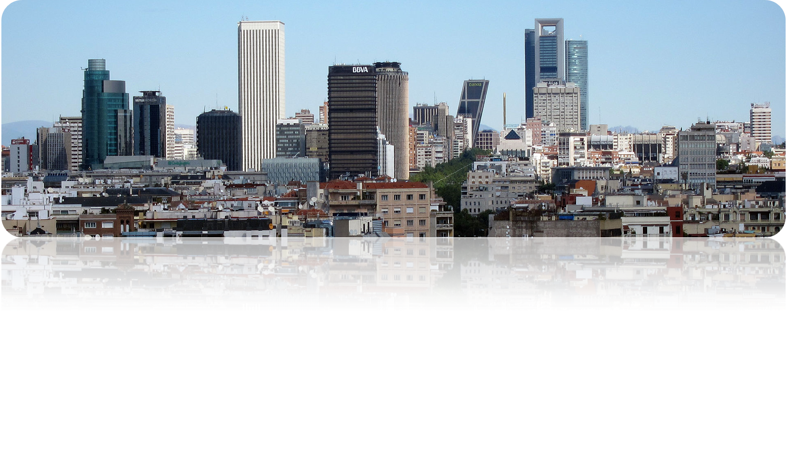
As a national capital, with the government and the Spanish monarch residence, Madrid is also the political, economic and cultural centre of Spain. Madrid is also the official residence of: the World Tourism Organization (WTO) - belonging to the United Nations Organization (ONU), the Ibero-American States Organization (OEI), the Iberoamerican General Secretariat (SEGIB) and the European Office of the Interamerican Development Banc (IDB/BID).
Madrid is also the location for the International Organization of Securities Commissions (IOSCO), and the Public Interest Oversight Board (PIOB) that, along with Basle Committee, are the international bodies that design the global financial regulation. It is also the location for the European Financial Centres Roundtable, a european entity aimed at strengtheing the mutual interaction among the european financial centres and their relationship with the European Union bodies, that will play an important role in the definition of the forthcoming Capital Markets Union. .
. Madrid is also the “residence” for important institutions that regulate the Spanish language, as the Royal Spanish Academy (RAE), the Cervantes Institute .
Notes:
13

Slide 14
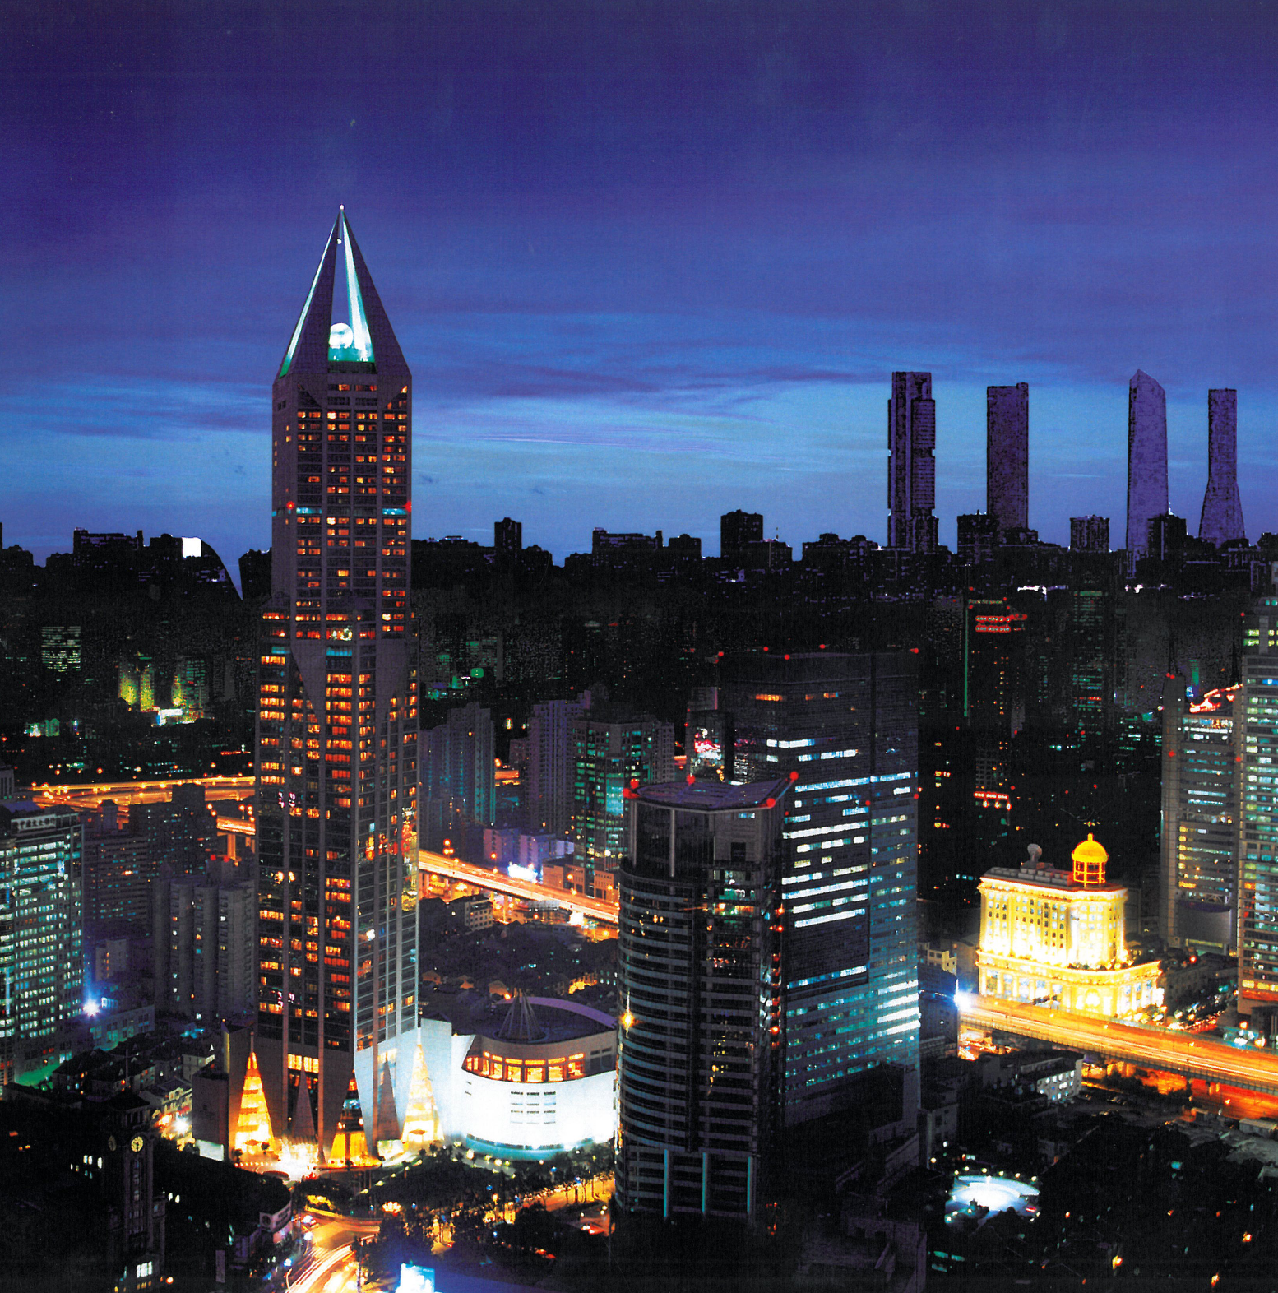
The Spanish metropolis has a major influence in politics, education, entertainment, environment, media, fashion, science, culture and arts among the cities of the European Union, which contributes to its status as one of the main urban centres in the world.
Notes:
14

Slide 15
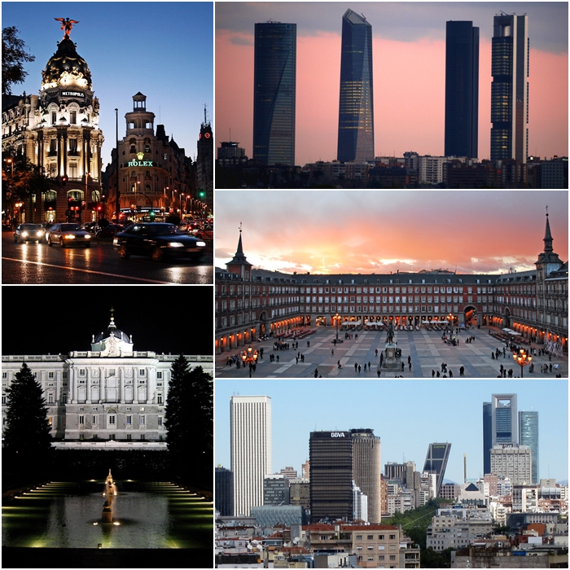
Due to its economic output, to its high standard of living and the size of its consumer market, Madrid is considered the major financial centre of Southern Europe and the Iberian Peninsula. The major Spanish companies: Telefónica, Repsol and Iberia are located in Madrid, too.
Madrid is the tenth most livable city in the world according to the 2010 classification of “Monocle” magazine, and it has been considered as one of the 12 greenest cities in Europe, in the same year.
Notes:
15

Slide 16

INFRASTRUCTURES
Notes:
16

Slide 17
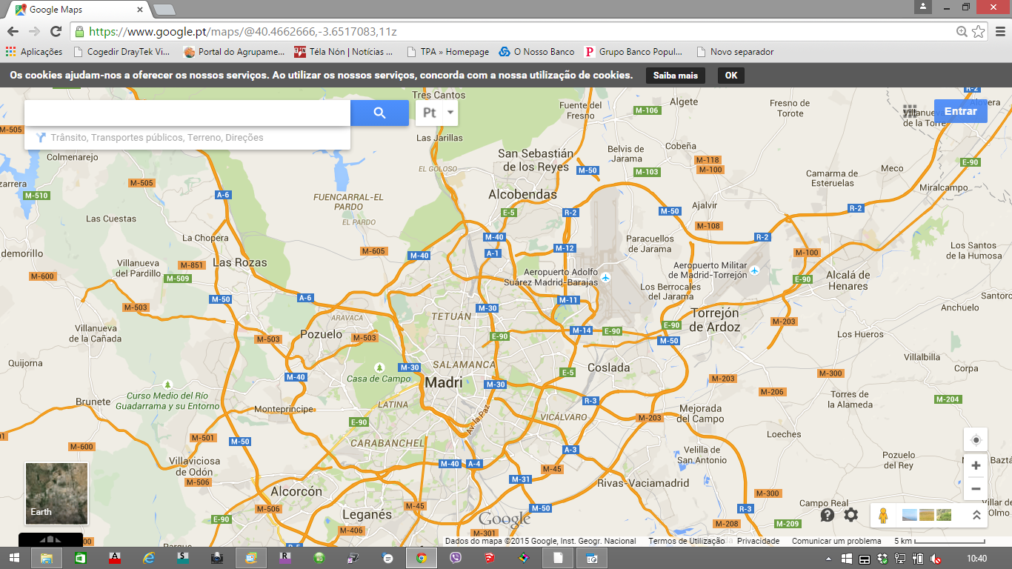
Road Connections / City of Madrid
Notes:
17

Slide 18
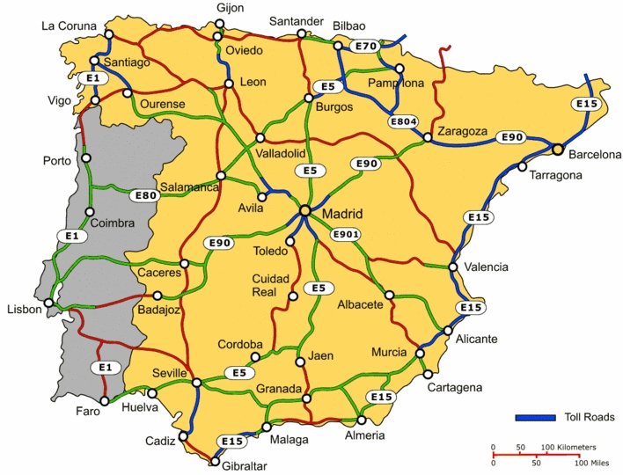
Road Connections / Iberian Peninsula
\
Notes:
18

Slide 19
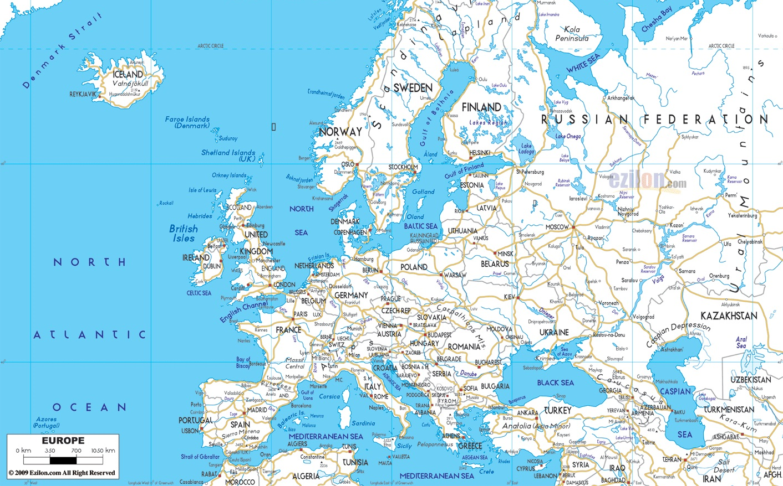

Road Connections / Madrid and Europe
Notes:
19

Slide 20
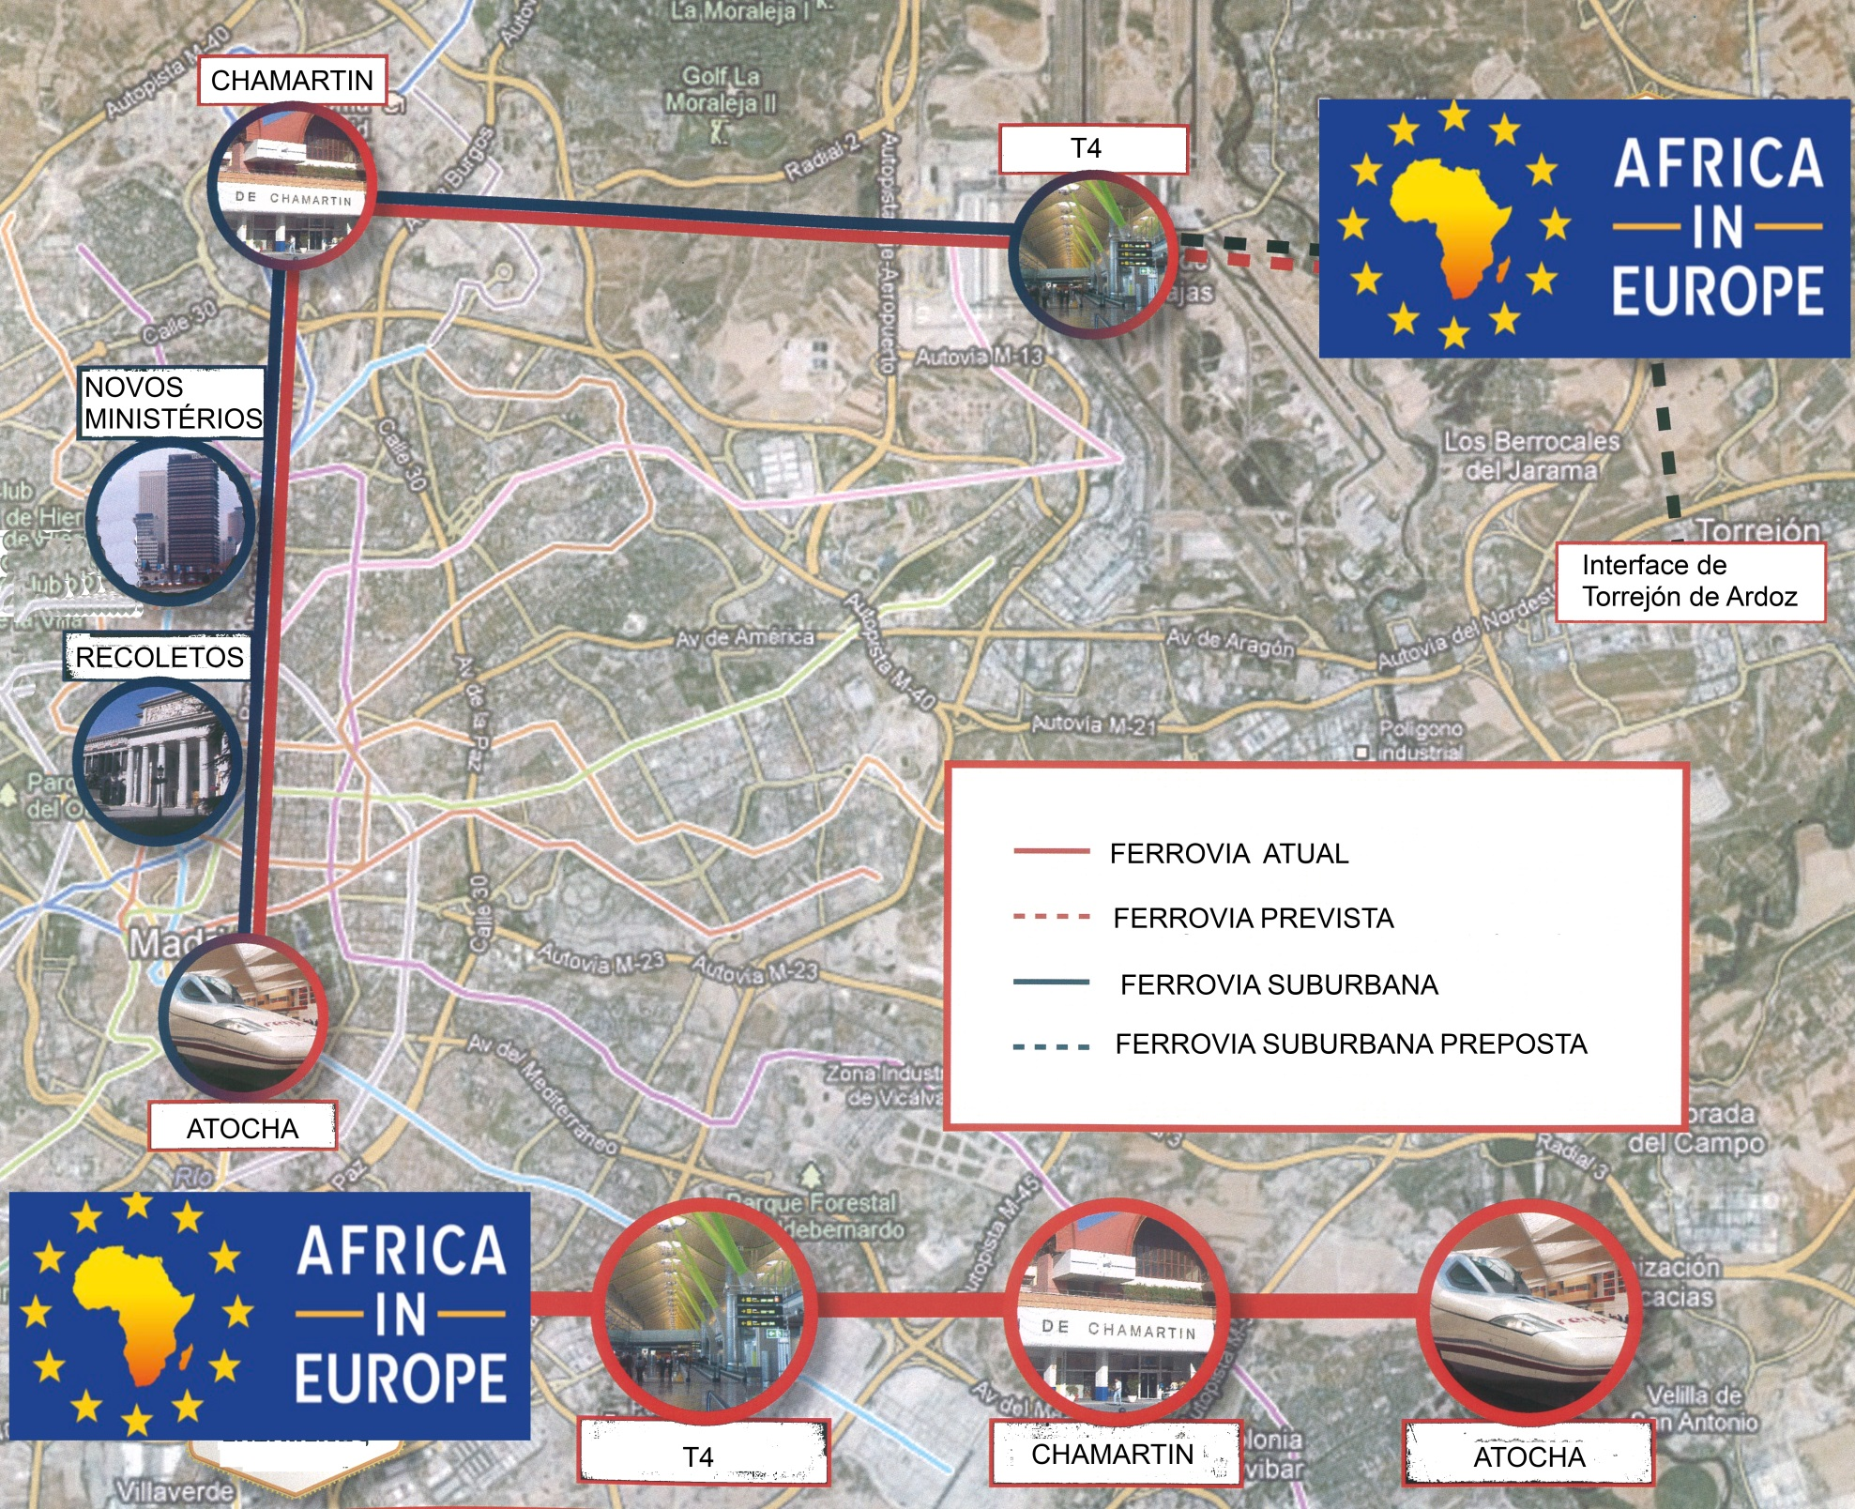
Rail Links / Madrid
Notes:
20

Slide 21
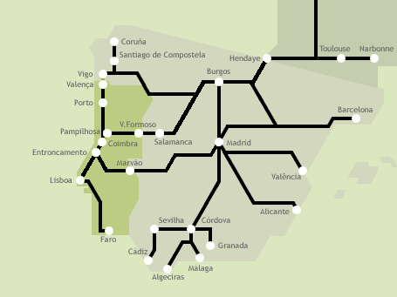

Rail Links / Madrid and Portugal
Notes:
21

Slide 22
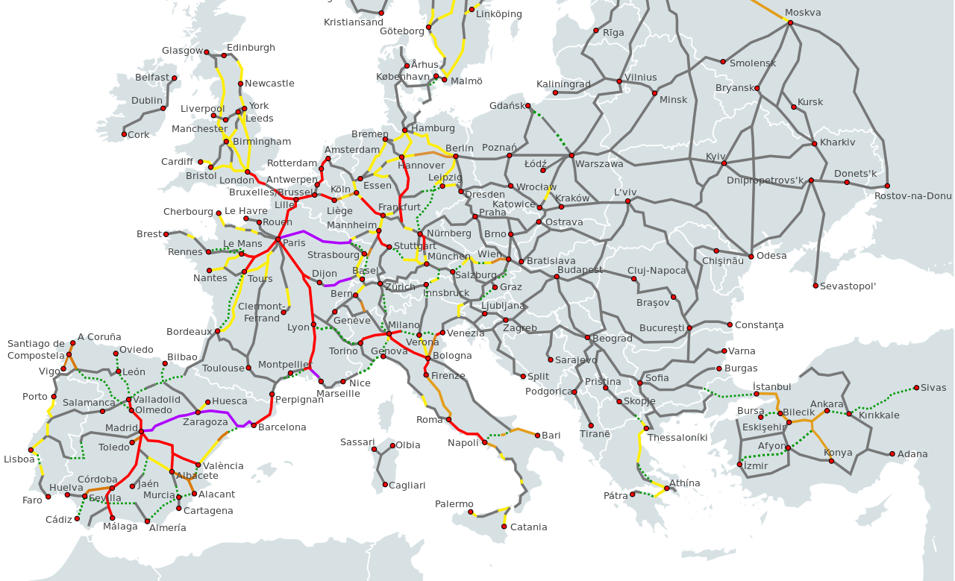
Rail Links / Madrid and Europe
Notes:
22

Slide 23
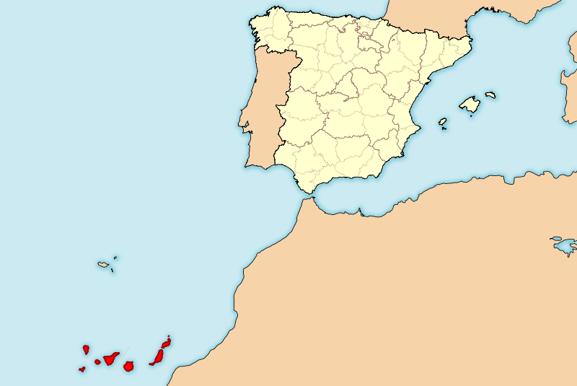

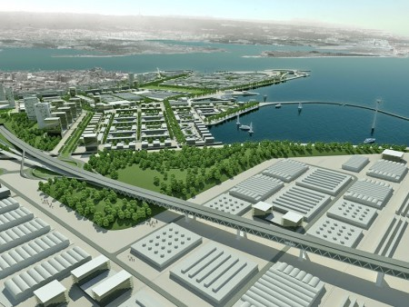
Connecting Infrastructure / Africa - Portugal - Spain
Leixões Port
Barreiro New Terminal
Sines Port
Shipping Links
Rail Links
Notes:
23

Slide 24

PROJECT
Notes:
24

Slide 25
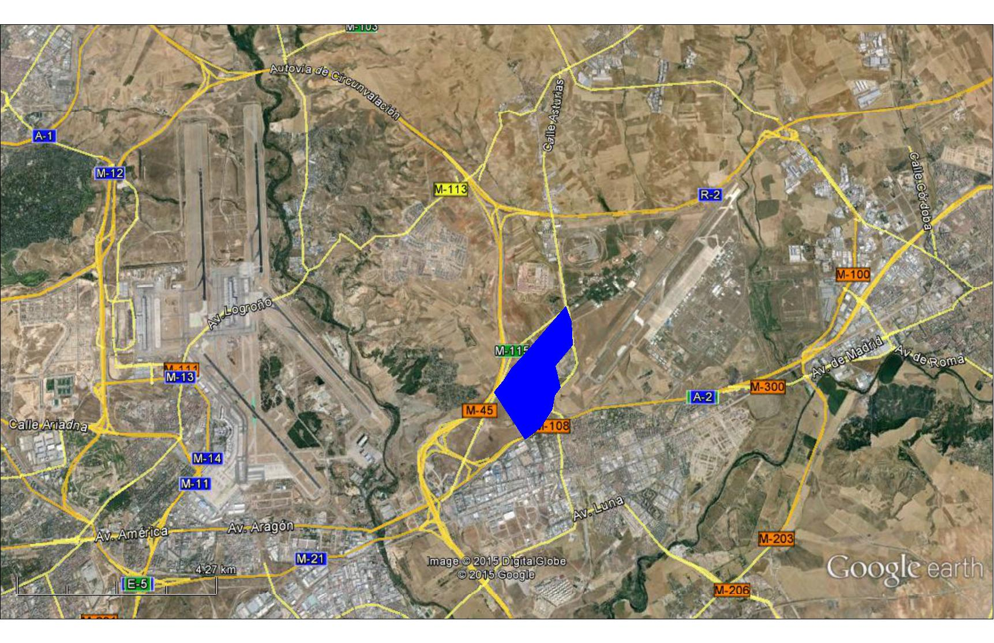
Land area
2,000,000m2
Notes:
25

Slide 26
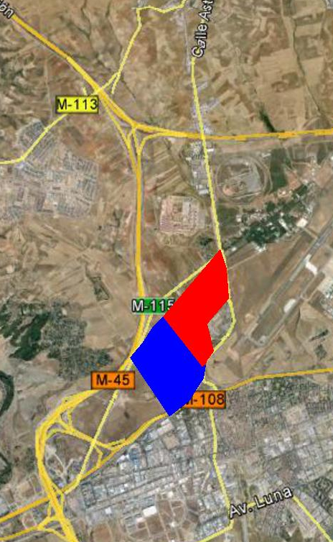
TOTAL LAND AREA
2 000 000 m²
CONVENTION CENTRE
FINANCIAL AND BUSINESS CENTRE
SHOPPING CENTRE
CULTURAL CENTRE
HOTELS AND APARTHOTEL
RESIDENTIAL AREA
1 000 000 m²
LOGISTICS CENTRE
1 000 000 m²
Notes:
26

Slide 27
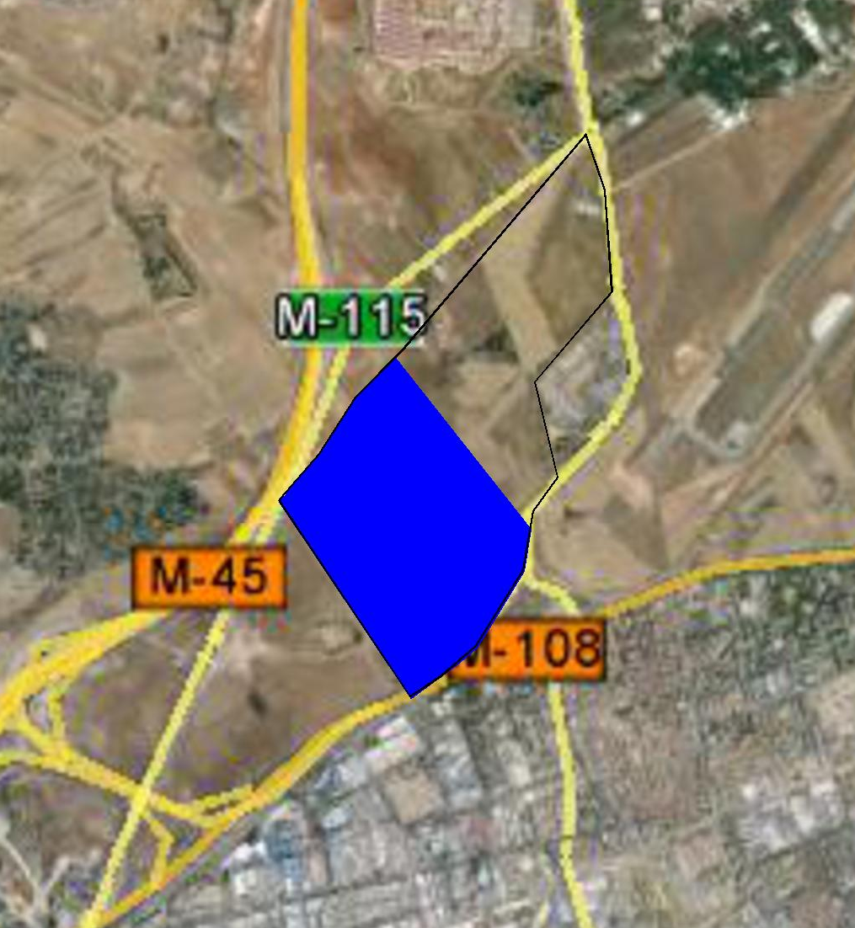

LOGISTICS
CENTRE
Notes:
27

Slide 28
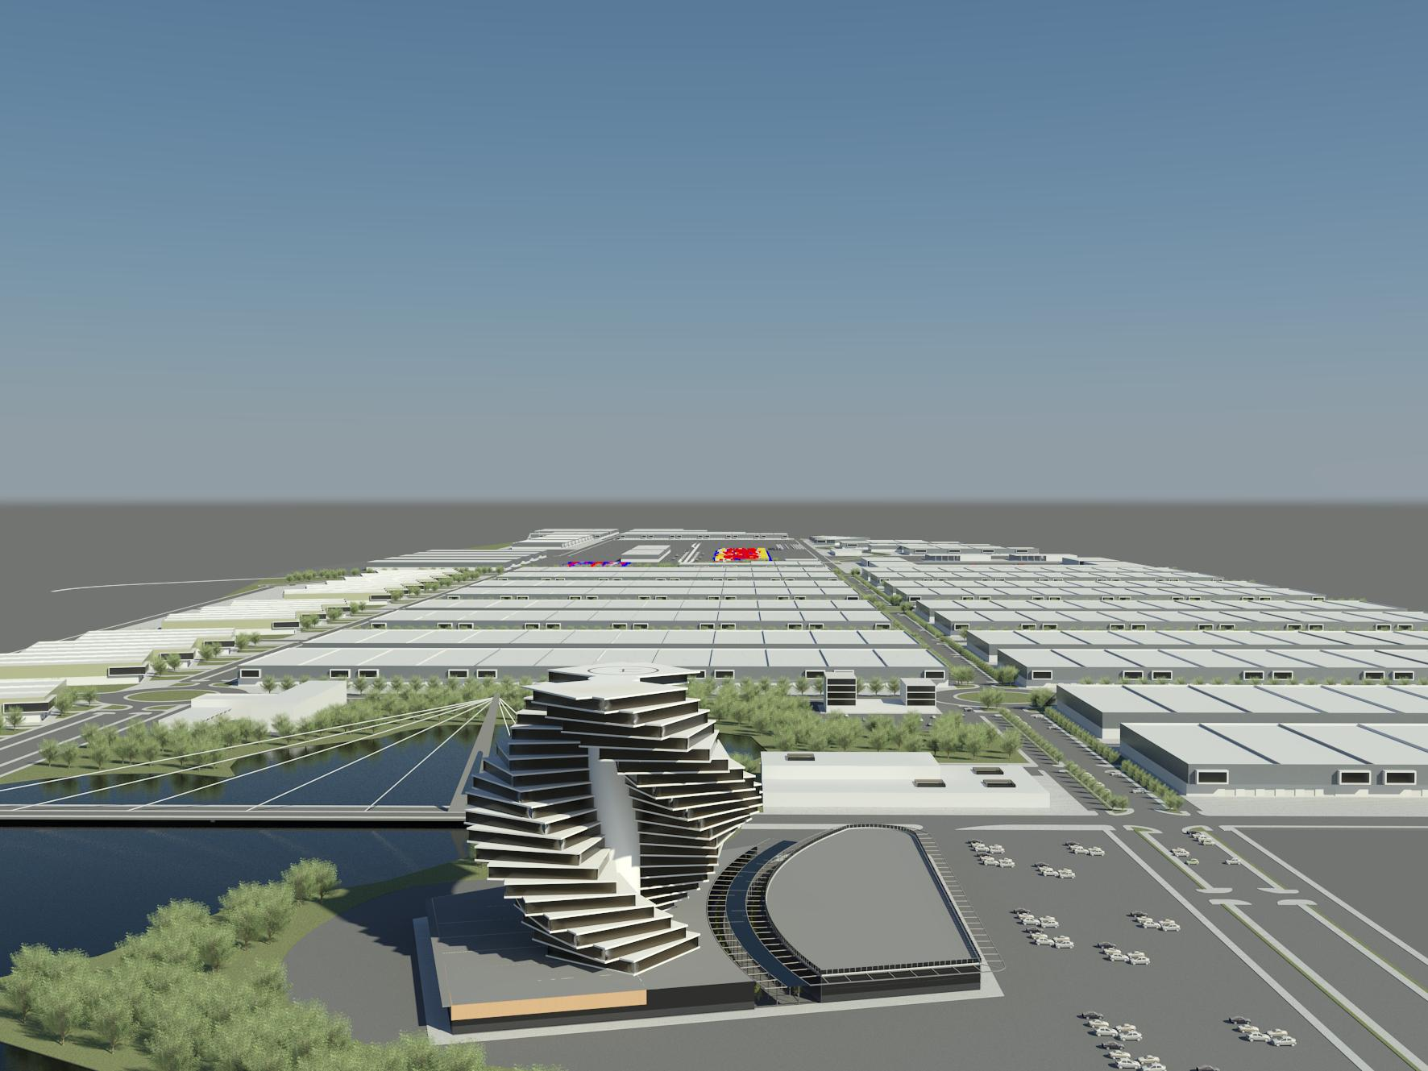

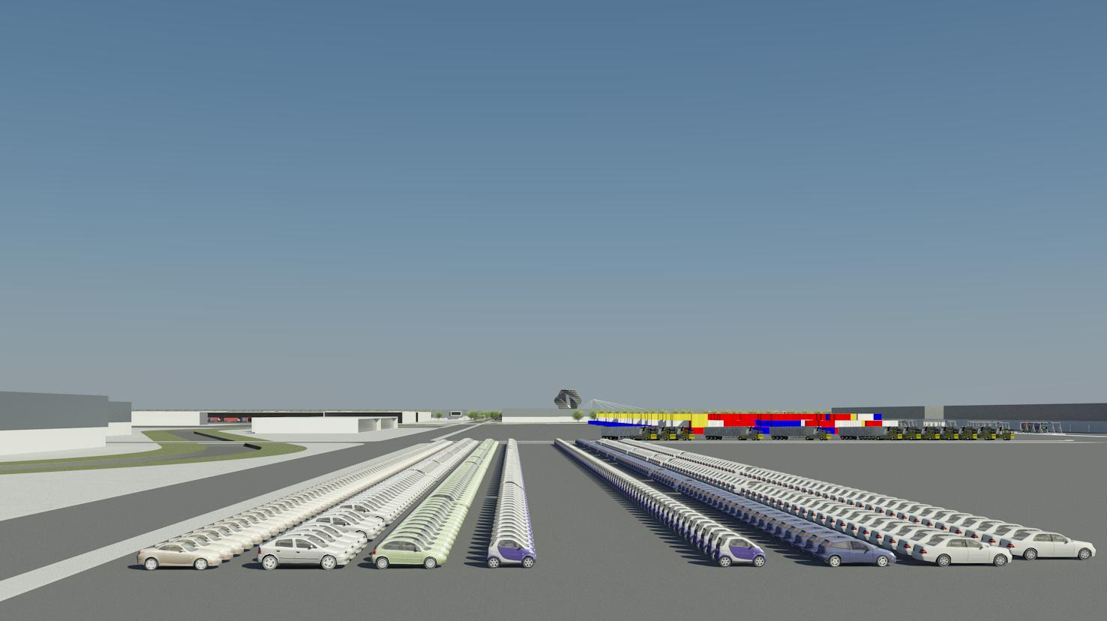

Africa In Europe Logistics offers areas devoted to industrial activities, logistics and services. Attractive conditions of land and provision of infrastructure make Africa in Europe Logistics a successful project, with an excellent location where you benefit from all the inherent synergies for the installation of activities in a logistics / industrial park.
In this proposal we highlight six areas with the following denomination:
Integrated Services Centre and Commercial Area
Logistics and Exhibition Area
Intermodal Centre of Goods
Road Transport Support Centre
Intermodal Logistics Area
Multifunctional Logistics Area
Notes:
28

Slide 29
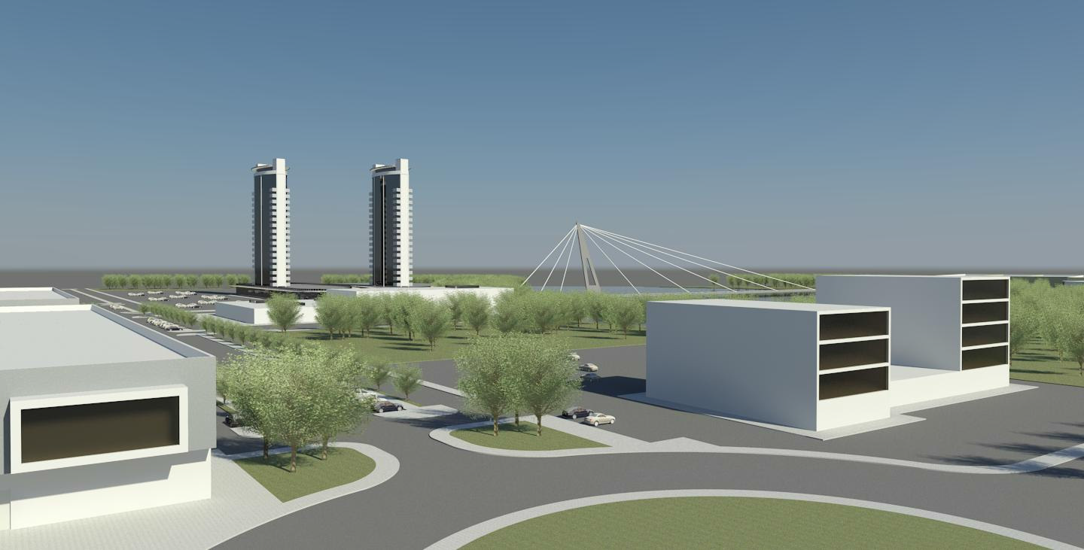
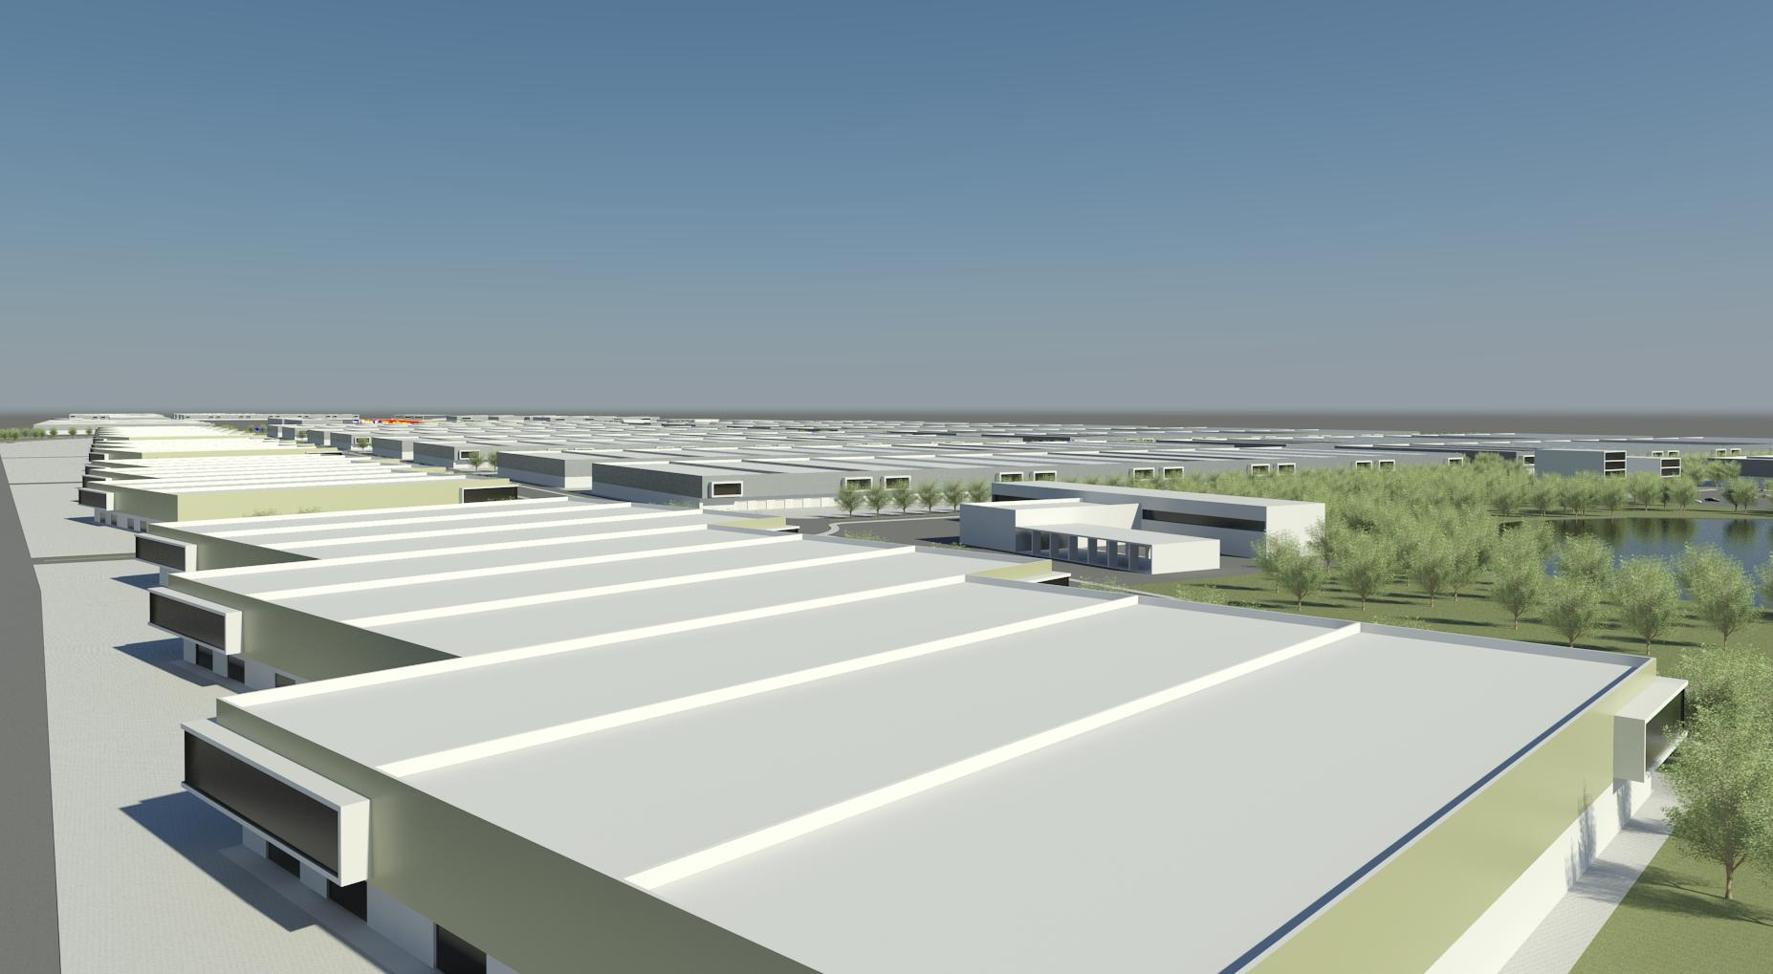
Integrated Services Centre and Commercial Area
Space for companies that do not require warehouses and where different kinds of support platform operation services will be available.
Area for the installation of commercial spaces which will complement the existing offers inside the Integrated Services Centre.
Functionalities
Business Centre (with auditoriums, meeting, training and exhibitions rooms).
Offices (modular from 80 m2).
Commercial support spaces (banks, insurance mediators, temporary employment agencies, convenience stores, stationery, laundry, etc.).
Restaurant area (self-service, pastry, cafeteria).
Heliport.
Notes:
29

Slide 30
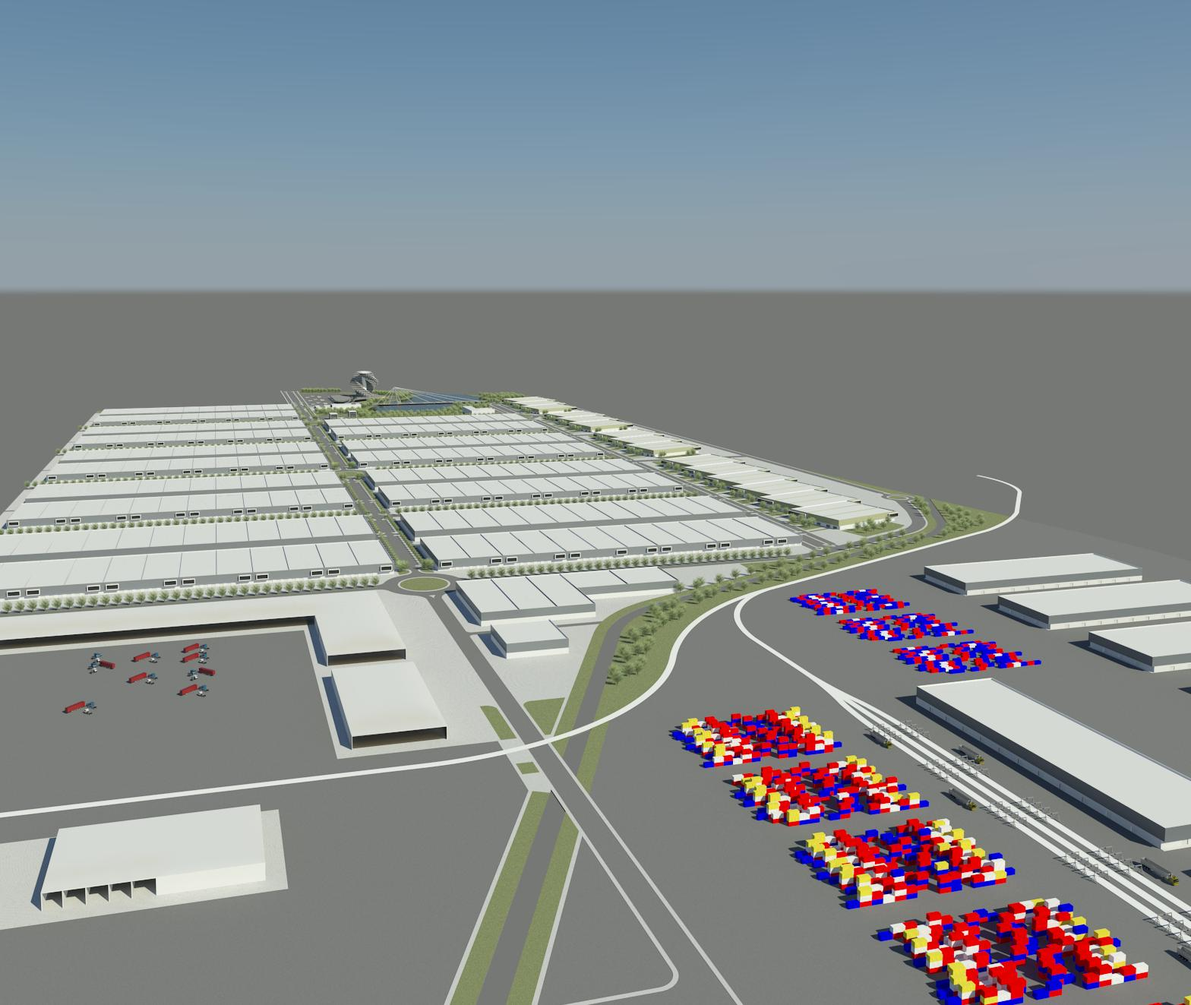
Logistics and Exhibition Area
An area of buildings with high visibility and storage space are the ideal solution to make products exhibitions.
Functionalities
Exhibition Area.
Terrestrial Distribution Centre.
Goods Groupage Centre.
Infrastructure.
Modular ships of 4.500 m2 to 12.500m2.
Modules from 2.500m2.
Wide Exhibition Area.
Notes:
30

Slide 31
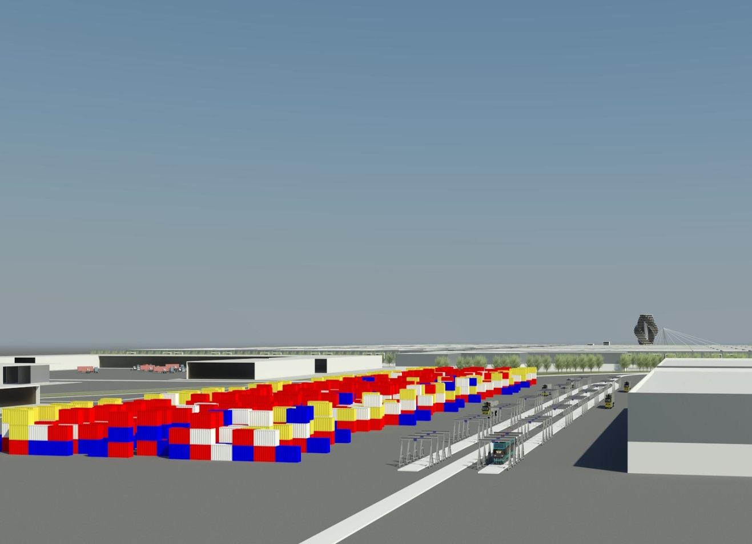
Intermodal Centre of Goods
Intermodal area of excellence. It allows parking compositions and goods handling.
Functionalities
Intermodal road/rail and rail/rail.
Regular ports shuttles .
General cargo handling.
Container repairs.
Full and empty container park.
Consolidation container deconsolidation.
Controlled Temperature container Management.
Stowage of containers (loading and unloading).
Customs, handling and processing of goods; customs broker; documentation management; storage customhouses goods.
Infrastructure
Reception and shipping lines.
Multipurpose rail lines (road / rail).
Overflow Lines (Rail / Rail).
Access lines to warehouses.
Maximum capacity of handling 300.000.
Notes:
31

Slide 32
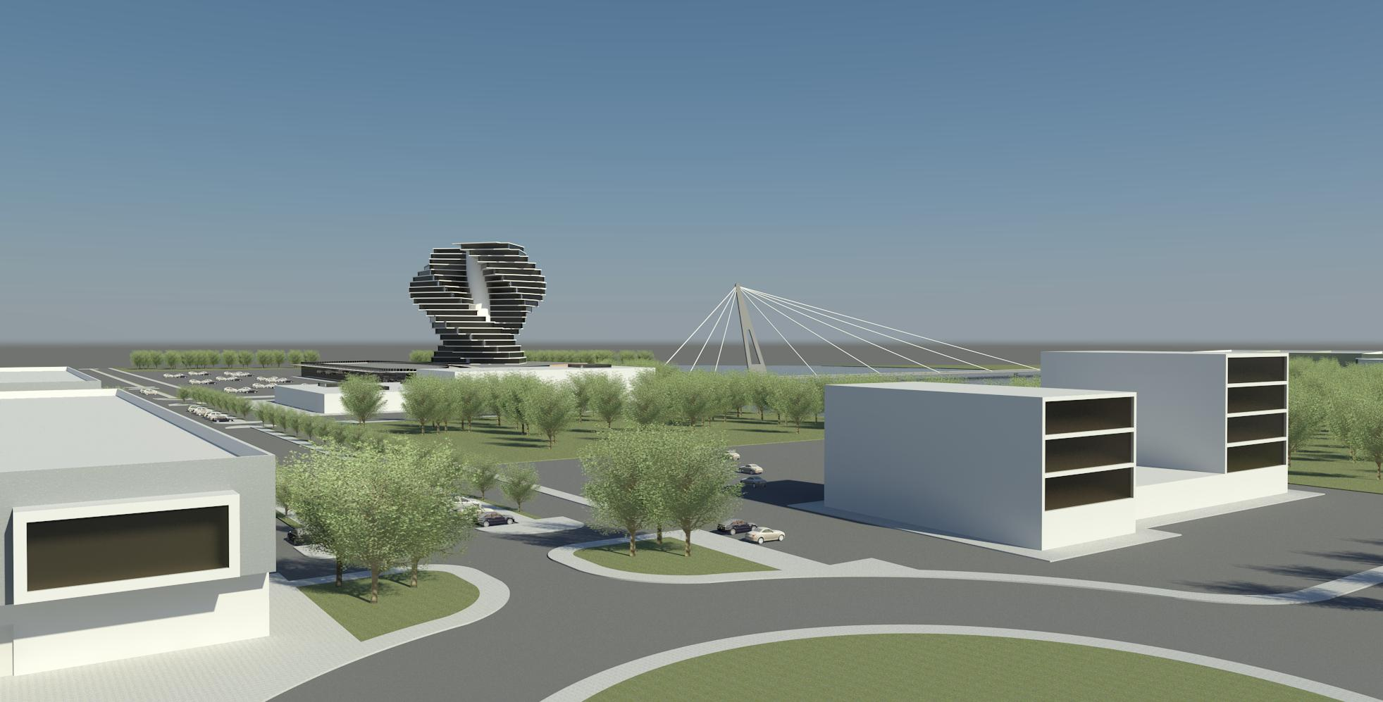
Road Transport Support Centre
Place dedicated to road transport, where infrastructure and services of maintenance of vehicles and people accommodation are provided.
Functionalities
Parking area for heavy vehicles, with rest area.
Vehicle service centers.
Fuel station.
Service area, cafeteria and catering.
Equipment rental service.
Accommodation areas and changing rooms.
Washing tunnels for automobile and lorries.
Inspection Center.
WWTP.
Infrastructure
32 ha guarded parking for trucks.
Fuel station for heavy and light vehicles.
Support services to transportation.
Building assistance.
Notes:
32

Slide 33
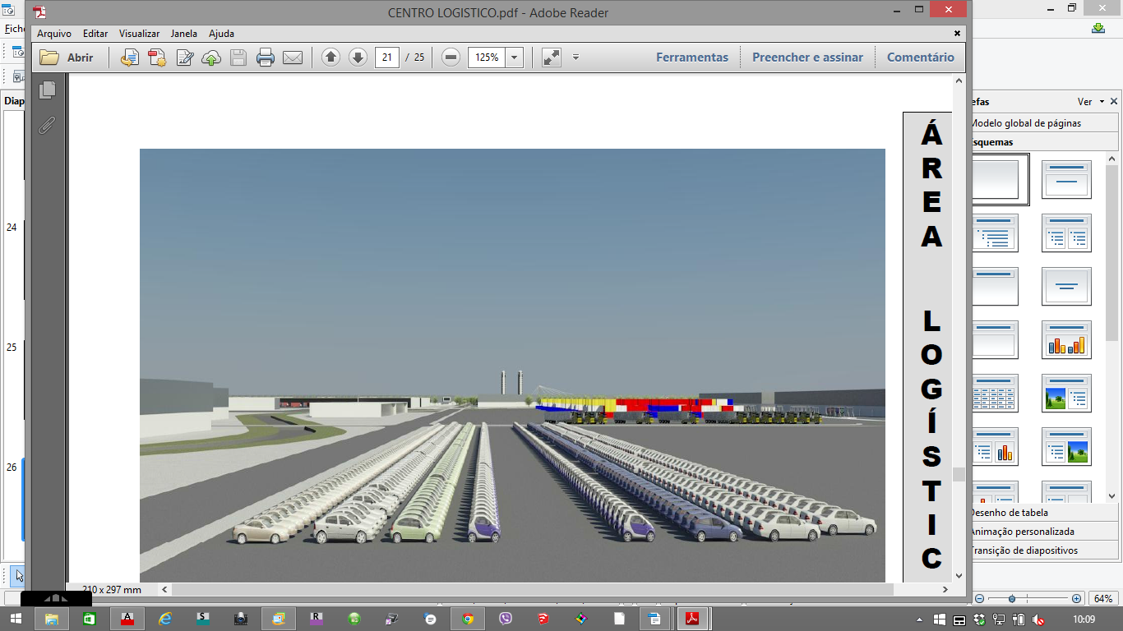
Intermodal Logistics Area
Area for the activities / products that do not require covered spaces.
All areas will be served by railway access due to the diversity of goods typology.
Functionalities
Multifunctional areas with low construction levels.
Availability of rail access.
For goods of high volume.
Infrastructure
Plots from 3,5 ha to 22 ha possibility for access by outside platform.
Notes:
33

Slide 34
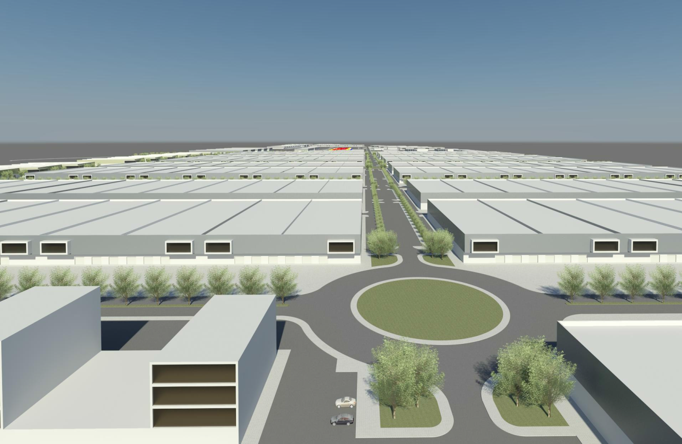
Multifunctional Logistics Area
An area for logistical activities that require indoor spaces. A space of modules which allows a great flexibility in warehouses building, whether they are intended for storage, processing, deconsolidation or to urban distribution.
Functionalities
Land Distribution Centre.
Groupage platforms of goods.
Logistics and transformation centre.
Possibility of rail access.
Infrastructure
Modular Ships from 2.000 m2 to 24.000 m2
Warehouses Stand-Alone with areas greater than 100.000 m2.
Modules from 2.000 m2.
Total flexibility in the types of ships.
Notes:
34

Slide 35
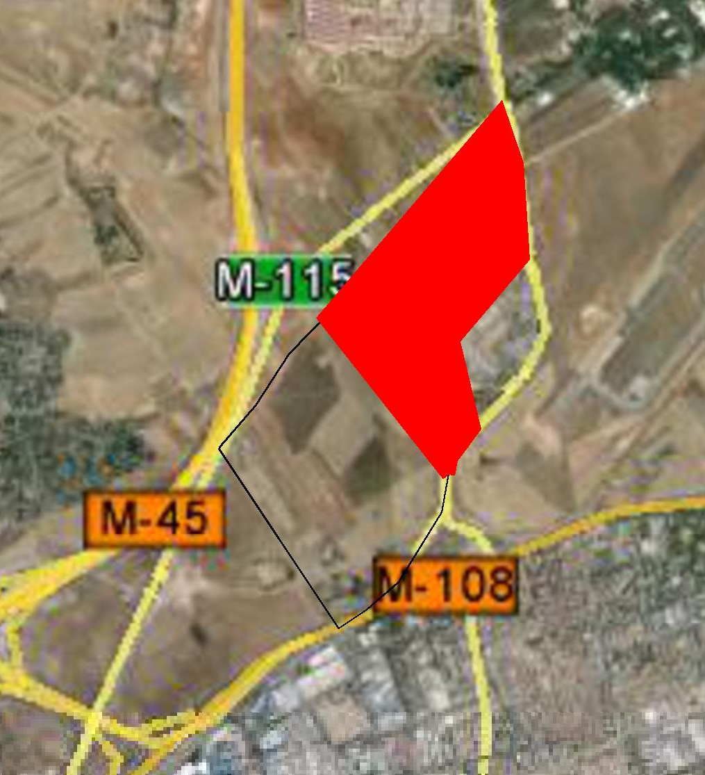

CONVENTION CENTRE
FINANCIAL AND BUSINESS CENTRE
SHOPPING CENTRE
CULTURAL CENTRE
HOTELS AND APARTHOTEL
RESIDENTIAL AREA
Notes:
35

Slide 36
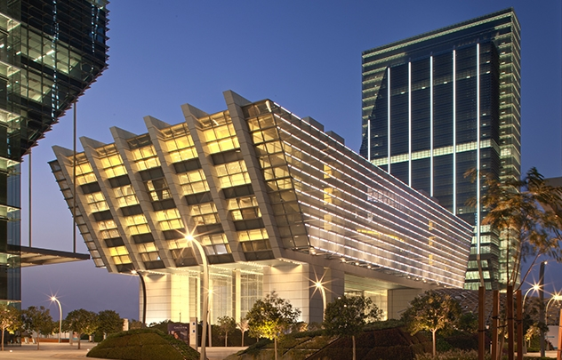

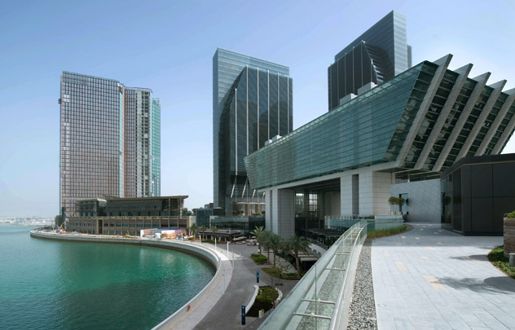
CONVENTION CENTRE
Place where events, lectures, exhibitions, concerts and conferences will take place.
We propose public buildings of large size to accommodate public and private companies in national and international social events.
Notes:
36

Slide 37
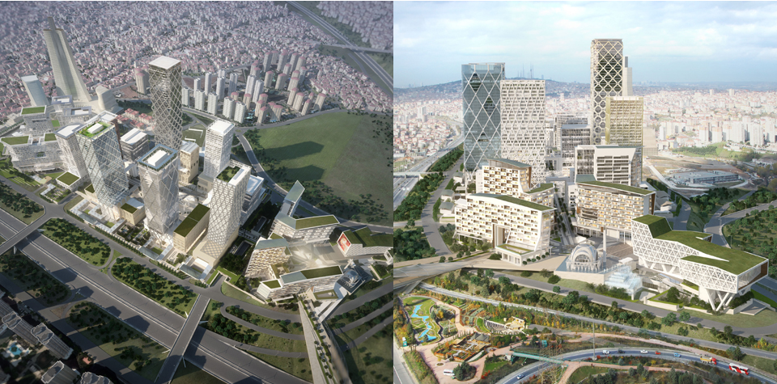
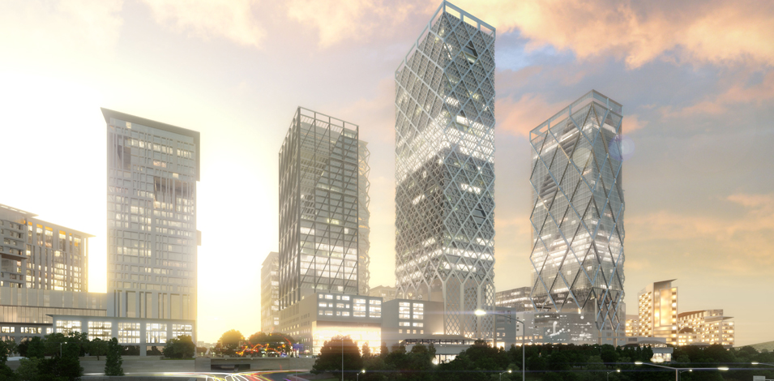

FINANCIAL AND BUSINESS CENTRE
This area is planned to be the most important financial and business Centre of the country.
Notes:
37

Slide 38
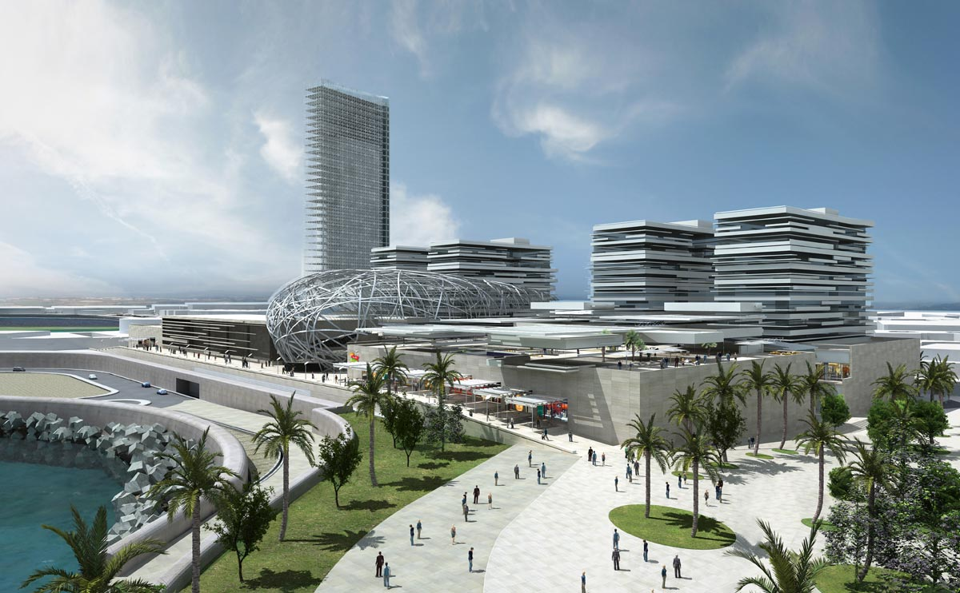

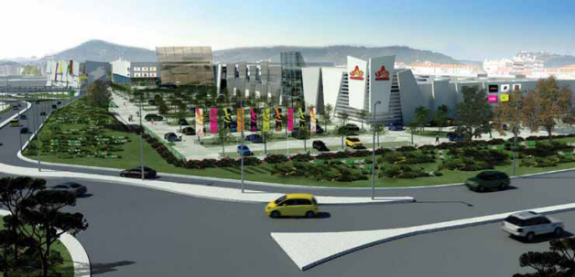
SHOPPING
CENTRE
SHOPPING CENTRE
It will be a structure with several stores, in particular, hypermarket, toys, appliances, furniture and decoration, fashion, stationery, fragrances, computers, catering, services, etc ..
It will also be equipped with movie rooms, playground and parking.
Notes:
38

Slide 39
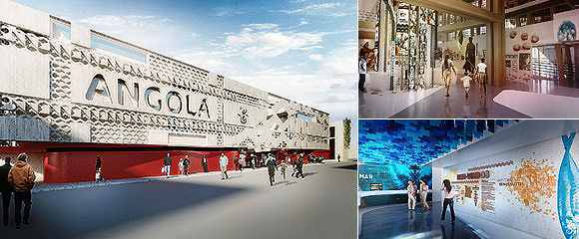

CULTURAL CENTRE
It will be a space for the presentation of cultural events of different kinds.
Notes:
39

Slide 40
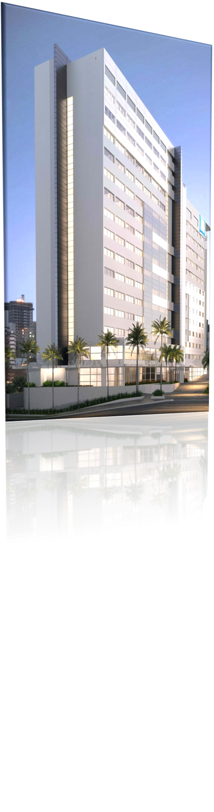
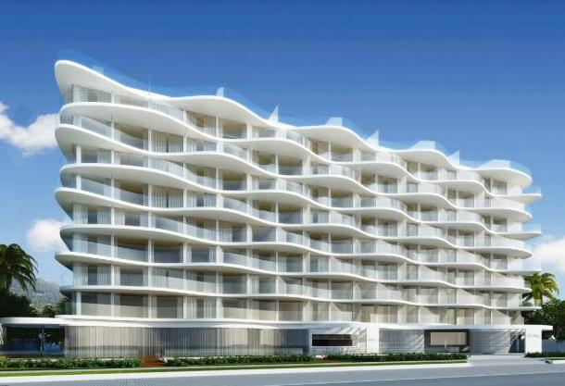
HOTELS AND APARTHOTEL
It is expected the creation of several hotels of different ratings to support all areas of Africa in Europe.
Notes:
40

Slide 41
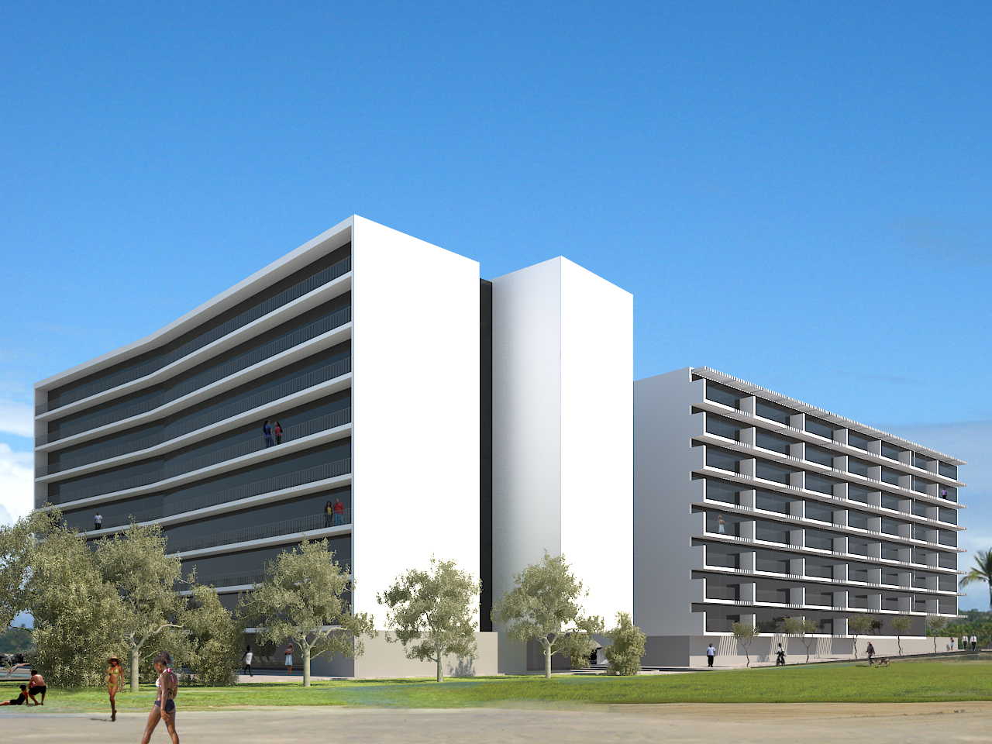


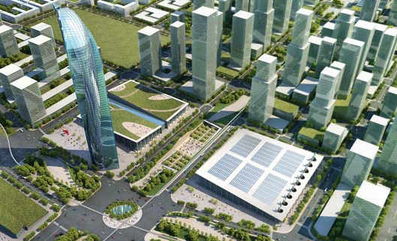
RESIDENTIAL
AREA
It will be implemented a Residential Area which will support everyone involved in Africa in Europe.
Notes:
41

Slide 42

CONTACTS
Contacts:
Spain | Dr. António Garrido | email: antoniogarrido@cepalopspain.com | tlf +034 670703455
Portugal | Engº Moutinho Cardoso | email: administracao@cogedir.pt | tlf +351 917556469
Angola | Dr. Francisco Viana | email: viana888@gmail.com | tlf +244 923788889
Notes:
42

